Slide 1

MEDICARE HEALTH INSURANCE
Final Project
Team 12
Amit Bendale
Priestley Fernandes
Vedansh Arora
Neil Dias
Vedant Mahendra

Slide 2

01
TABLE OF CONTENTS
ABOUT MEDICARE
02
BUSINESS ARCHITECTURE AND BUS MATRIX
03
LOGICAL DIMENSIONAL MODEL
04
CONFORMED DIMENSIONS
05
TRANSFORMATION RULES
06
AGGREGATE TABLES
07
MDDB CUBES
08
BI PORTAL AND SYSTEM DESIGN

Slide 3
01
ABOUT MEDICARE

Slide 4

WHAT IS MEDICARE?
Medicare is a government national health insurance program in the United States, begun in 1965 under the Social Security Administration (SSA)
Administered by the Centers for Medicare and Medicaid Services (CMS).
It primarily provides health insurance for Americans aged 65 and older, but also for some younger people with disability status as determined by the SSA(Social Security Administration)

Slide 5
Medicare Parts: Medicare is divided into four Parts: A, B, C and D.
Part A
covers hospital (inpatient, formally admitted only), skilled nursing (only after being formally admitted to a hospital for three days and not for custodial care), home health care, and hospice services.
Part A
Covers outpatient services including some providers' services while inpatient at a hospital, outpatient hospital charges, most provider office visits even if the office is "in a hospital", durable medical equipment, and most medical drugs
Part C
Allows patients to choose health plans with at least the same service coverage as Parts A and B (and most often more), often the benefits of Part D, and always an annual out-of-pocket expense limit which A and B lack.
Part D
Covers mostly self-administered prescription drugs.

Slide 6

BUSINESS ARCHITECTURE
AND BUS MATRIX

Slide 7
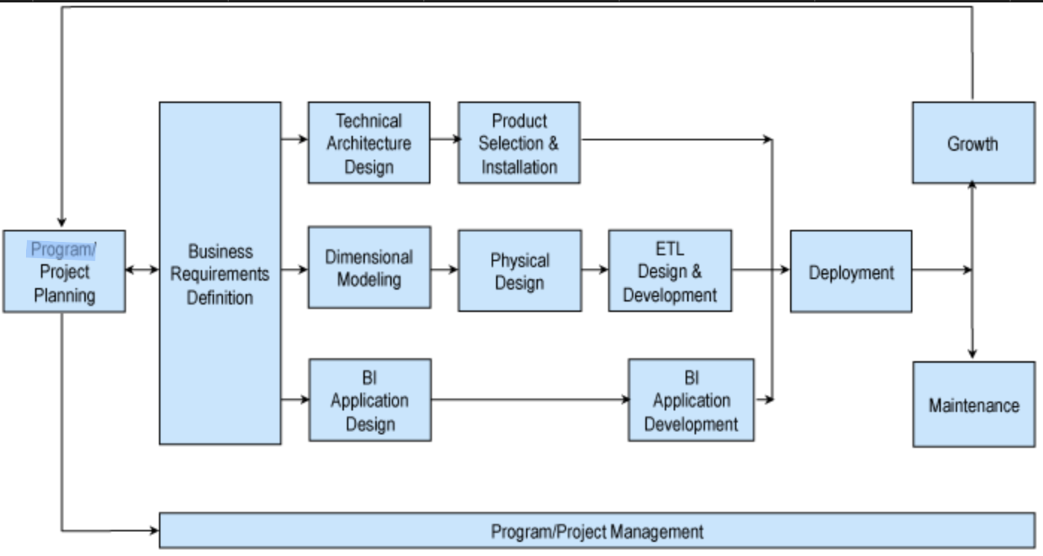
BUSINESS DIMENSIONAL LIFECYCLE

Slide 8
HIGH LEVEL BUS MATRIX
Business processes | Time | Location | Policy | Claims | Beneficiary | Provider | Charges | Payment | Drug | Physician | Supplier
Treatment facilities | X | X | X | X | X | X | X | X
Patient charges | X | X | X | X | X | X | X | X | X
Drug prescriber, supplier and physician details | X | X | X | X | X | X | X | X | X | X | X
Medical Equipment and drug provision | X | X | X | X | X | X | X |  | X |  | X

Slide 9
OPPORTUNITY MATRIX
Business processes | Finance | HR | Sales and Marketing | Logistics | CRM | Operations | Strategy Management
Home Health agency | X | X | X |  | X | X | X
Hospice provider | X | X | X |  | X | X | X
Hospital | X | X | X |  | X | X | X
Nursing facilities | X | X | X |  | X | X | X
Outpatient Charges | X |  |  |  | X | X | X
Inpatient Charges | X |  |  |  | X | X | X
Prescriber | X | X | X |  | X | X | X
Physician and other suppliers | X | X | X |  | X | X | X
Referring Durable And medical equipment | X | X |  | X | X | X | X

Slide 10
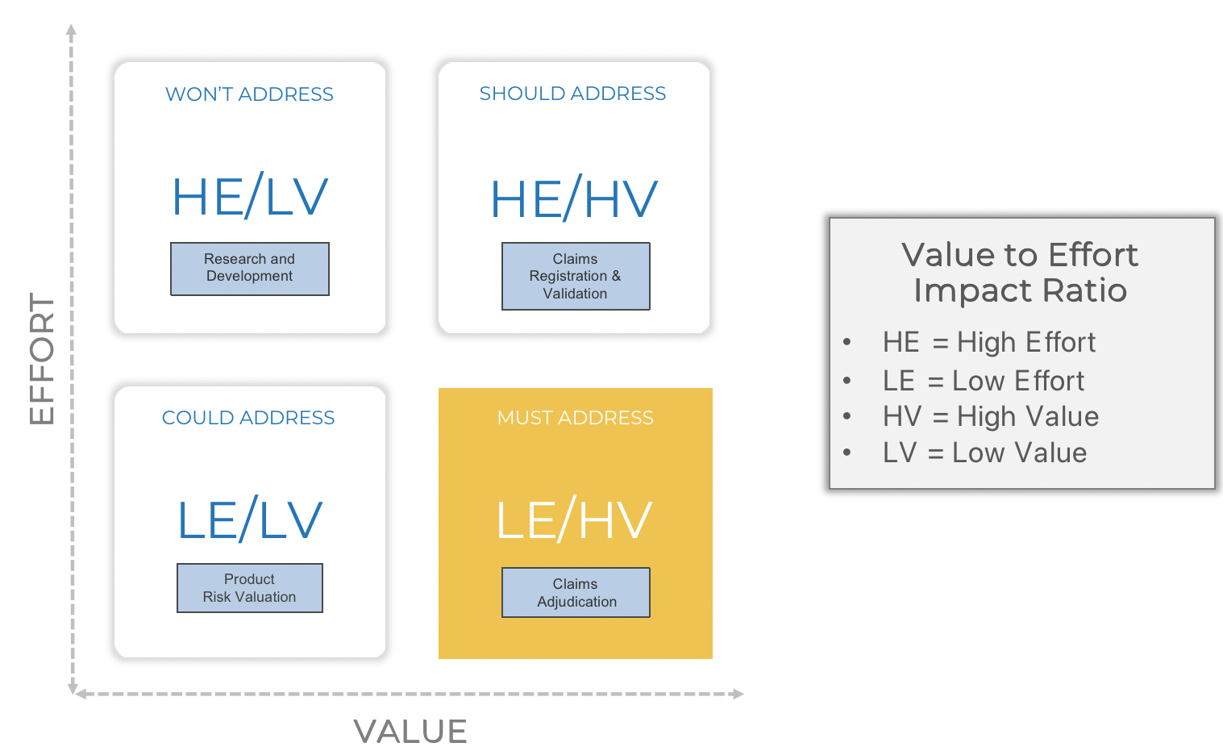
MOSCOW CAPABILITY GAP ANALYSIS

Slide 11
LOW LEVEL BUS MATRIX
Business processes/ Features | Time | Location | Policy | Claims | Beneficiary | Provider | Charges | Payment | Drug | Physician | Supplier
Product Development | X | X | X |  | X | X
Distribution and Underwriting | X | X | X |  |  | X | X |  |  | X | X
Policy management and Servicing | X | X | X | X | X | X | X | X
Claims Administration | X | X | X | X | X | X | X | X | X | X | X
HR |  |  |  |  |  | X
Finance |  |  | X | X | X | X | X | X
Marketing |  |  | X |  | X | X | X |  |  | X | X
Procurement | X | X | X |  | X | X |  |  | X |  | X
Customer Services |  |  | X |  | X | X |  |  |  | X | X

Slide 12
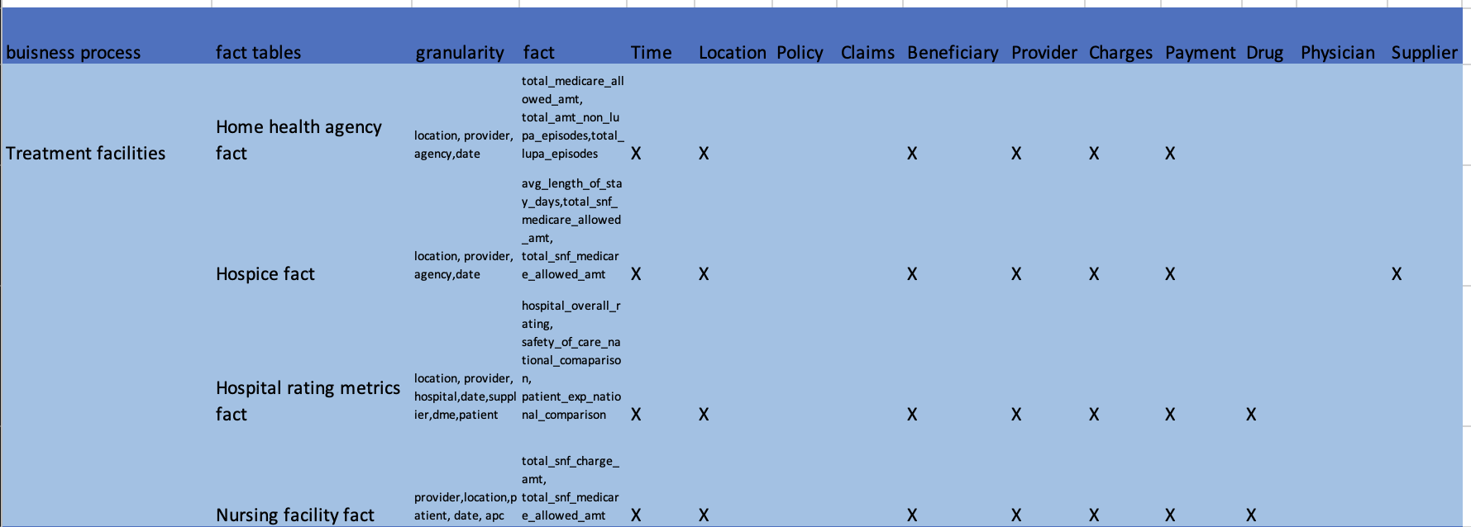
DETAILED BUS MATRIX

Slide 13
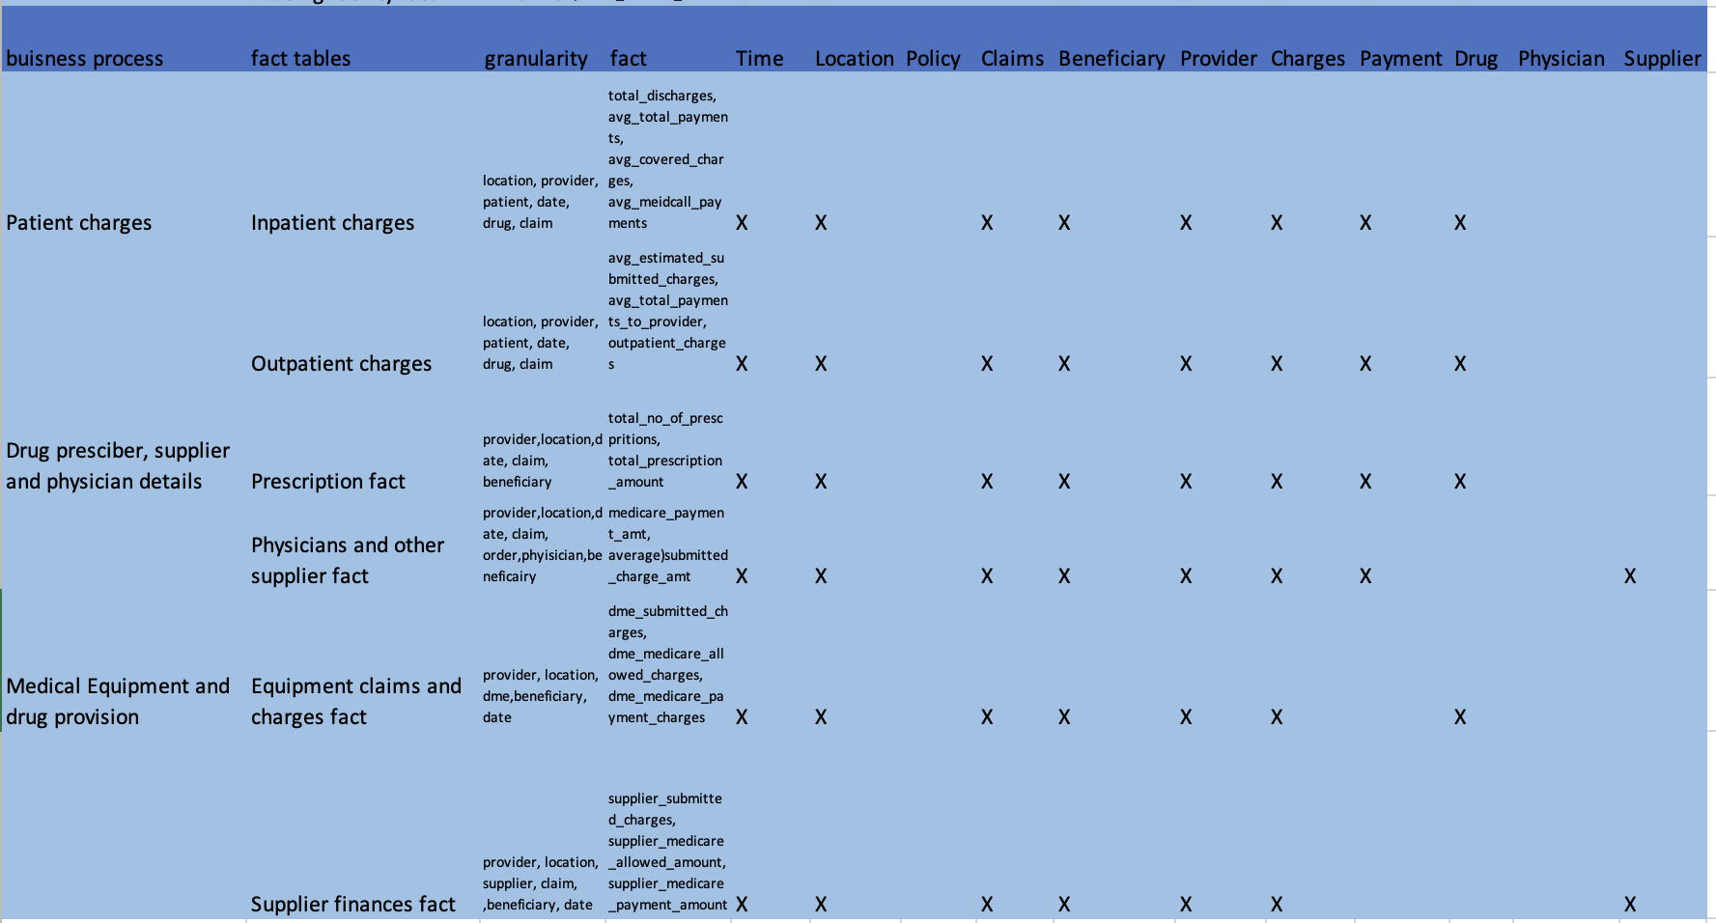
DETAILED BUS MATRIX

Slide 14
LOGICAL
DIMENSION
MODELLING

Slide 15

FACT TABLES

Slide 16
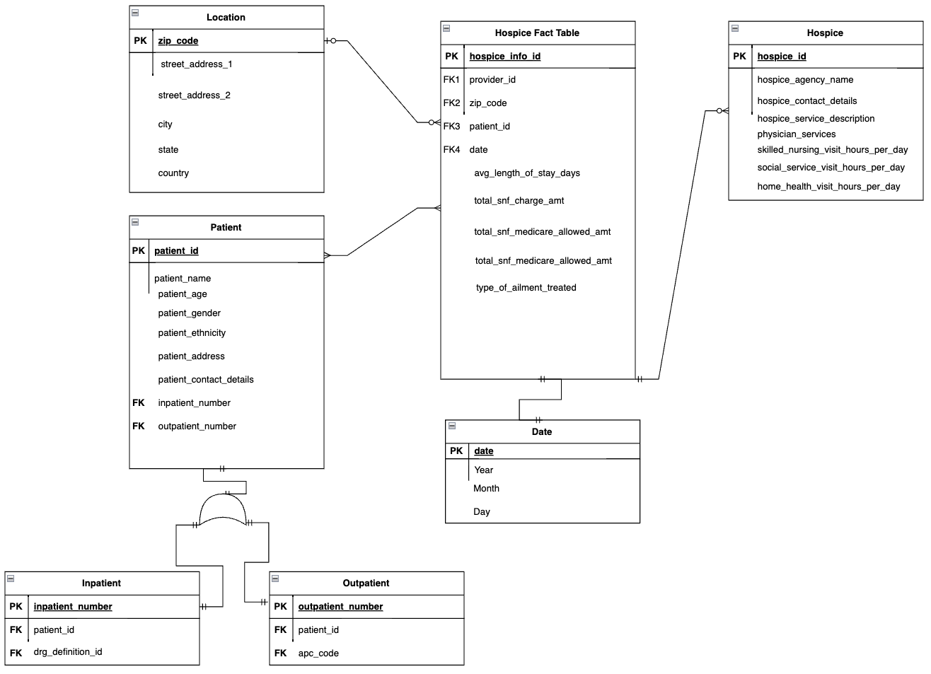
Hospice Star Schema:
Hospice Fact

Slide 17
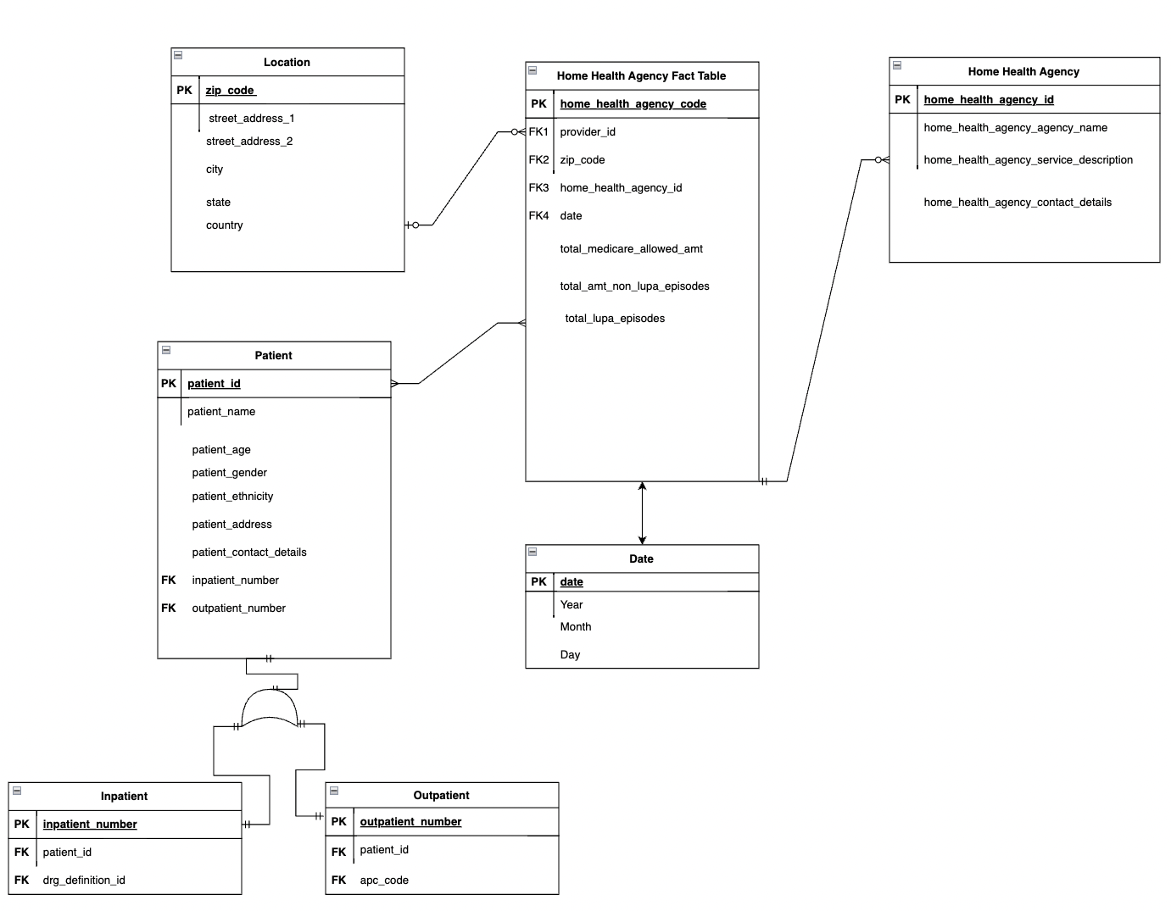
Home Health Star Schema:
Home Health Agency Fact

Slide 18
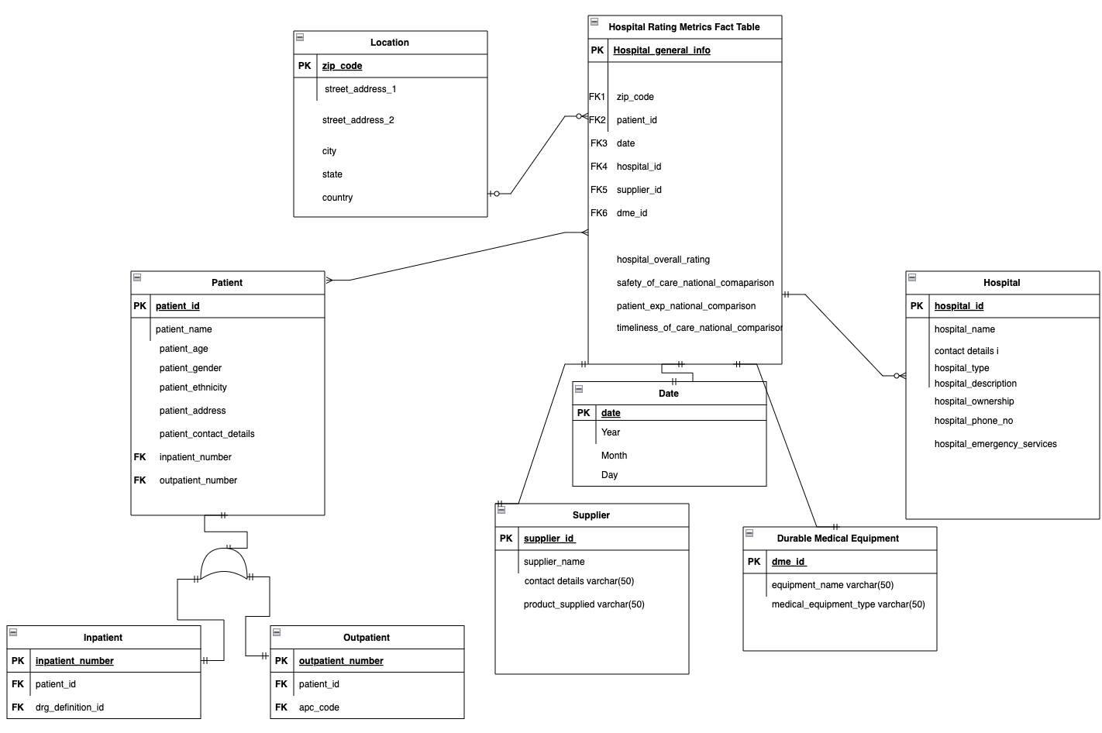
Hospital General Info Star Schema:
Hospital Rating Metrics Fact

Slide 19
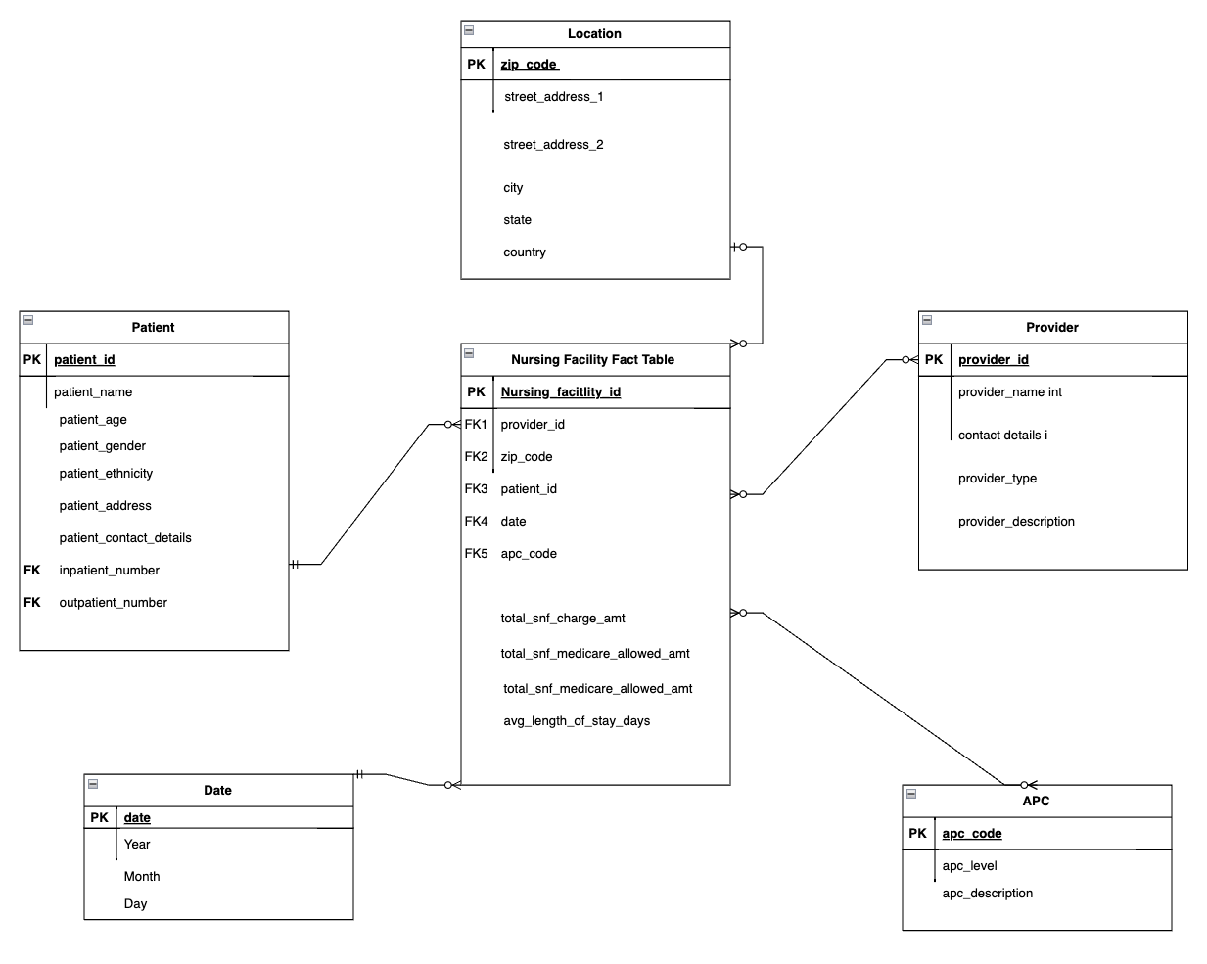
Nursing Facilities Star Schema:
Nursing Facility Fact

Slide 20
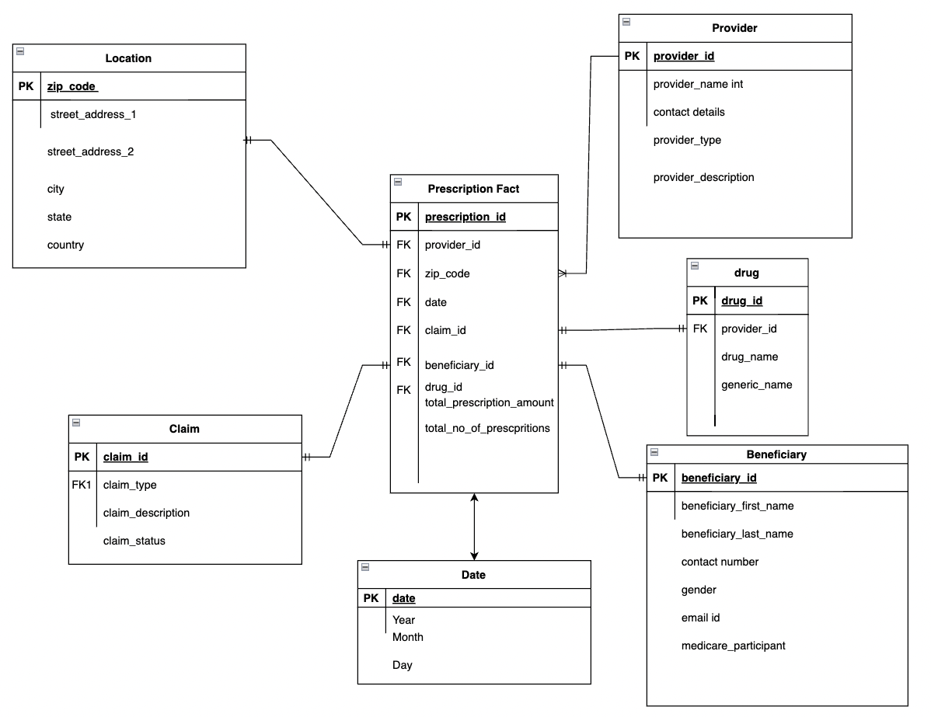
Prescriber Star Schema:
Prescription Details Fact

Slide 21
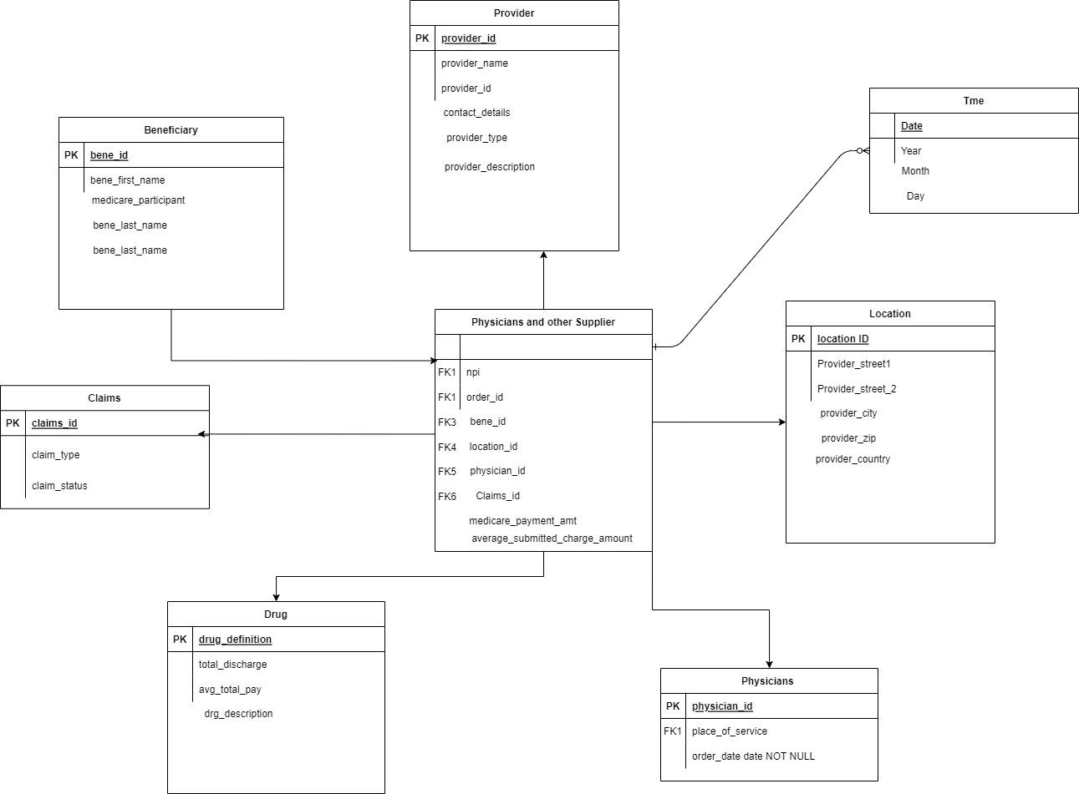
Physician Star Schema:
Physician and other supplier Fact

Slide 22
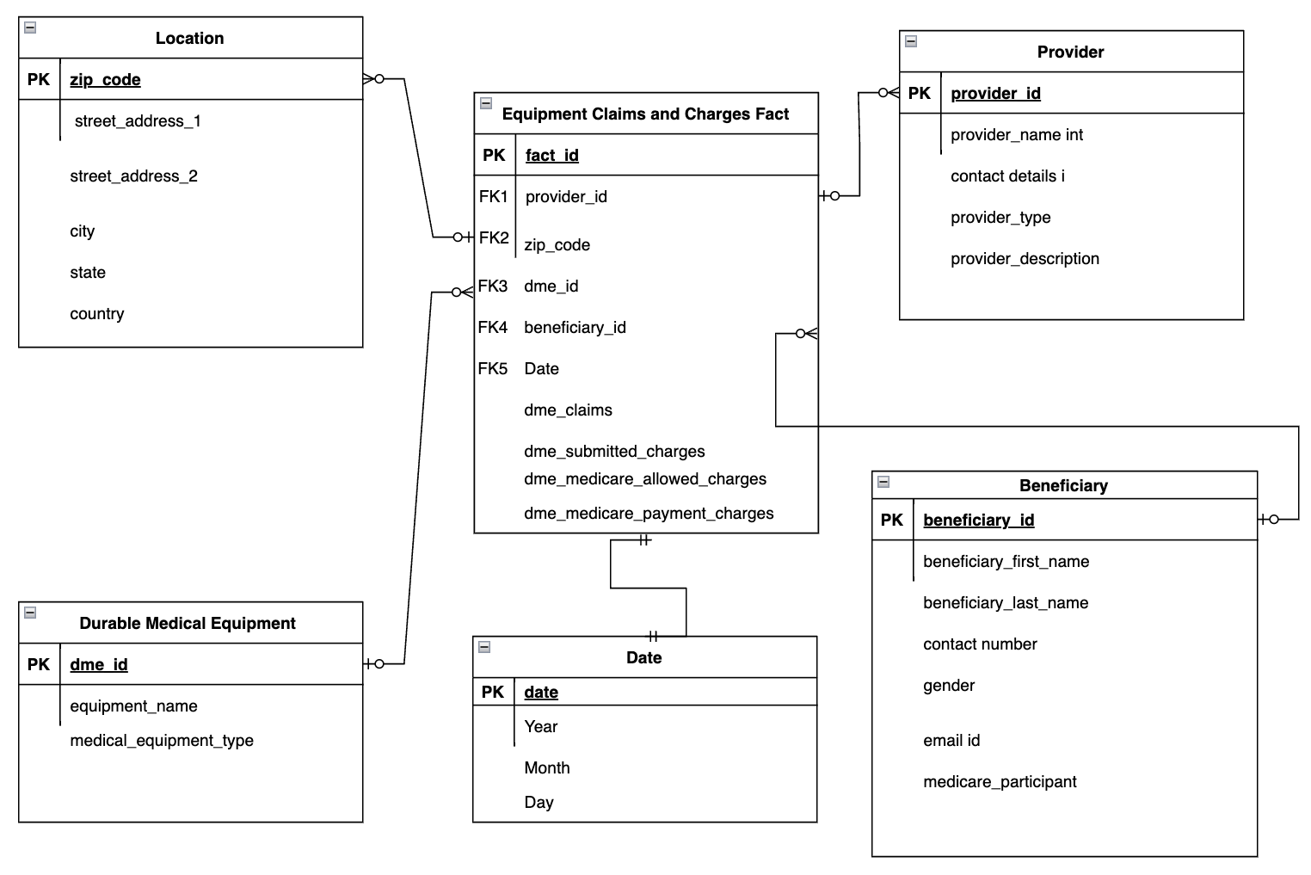
Equipment Claims Star Schema:
Equipment Claims and Charges Fact

Slide 23
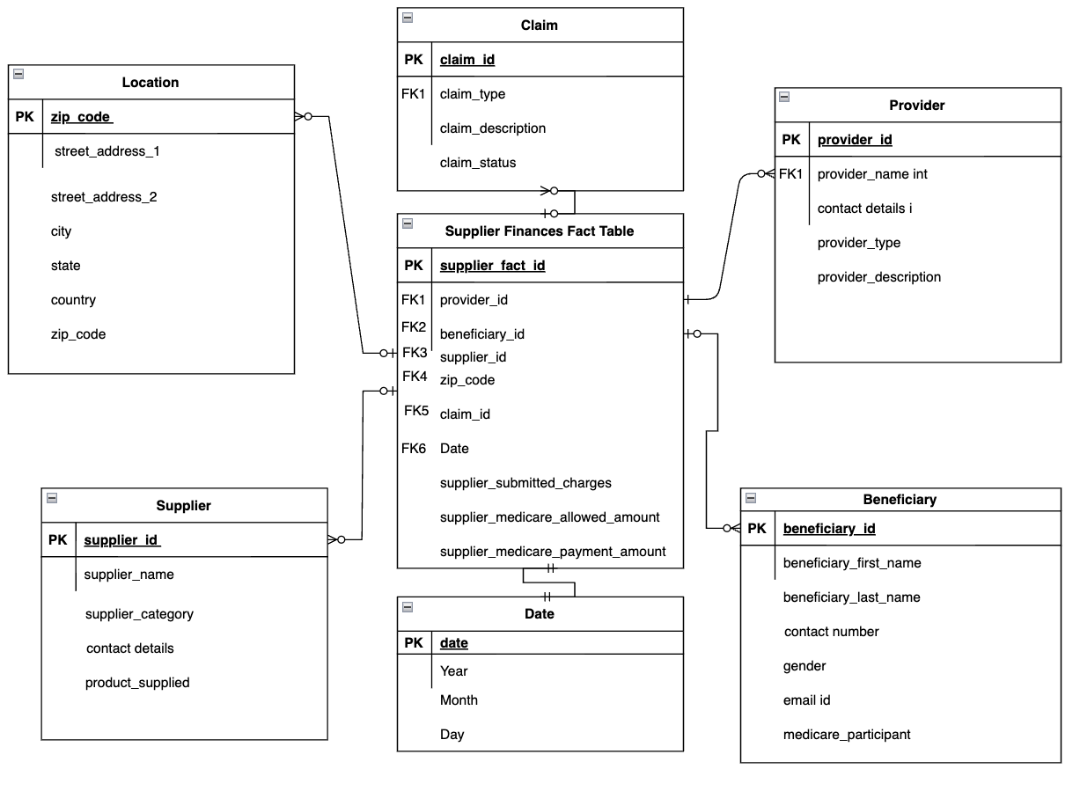
Supplier Finances Star Schema:
Supplier Finances Fact

Slide 24
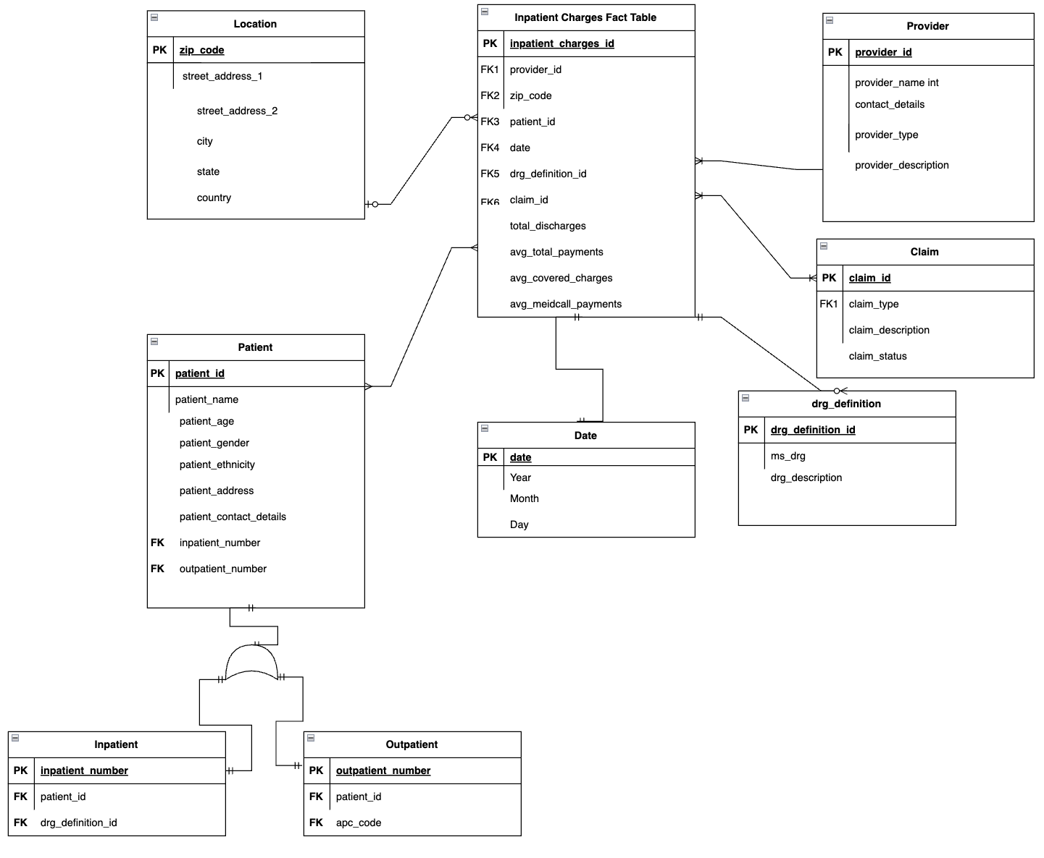
Inpatient Charges Star Schema:
Inpatient Charges Fact

Slide 25
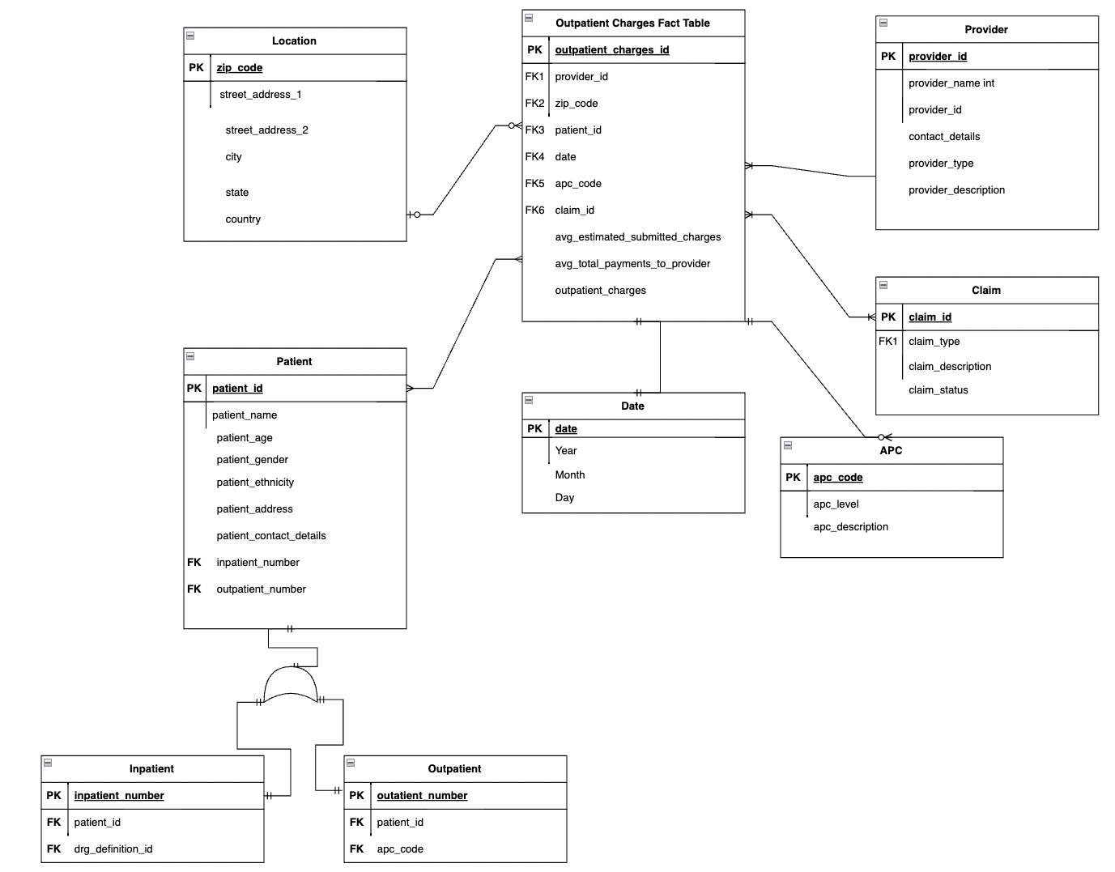
Outpatient Charges Star Schema:
Outpatient Charges Fact

Slide 26
AGGREGATE TABLES

Slide 27
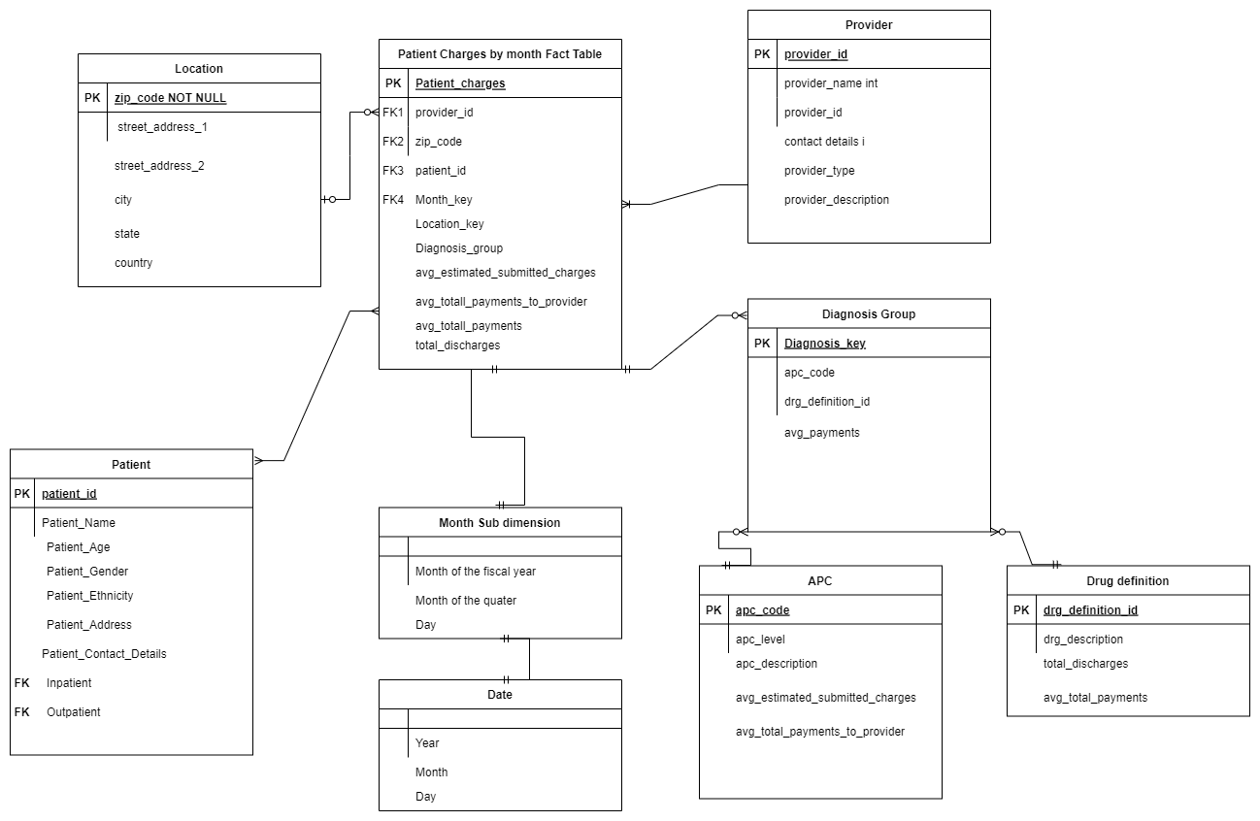
AGGREGATE TABLE

Slide 28

CONFORMED DIMENSIONS
Date
Patient
Location
Provider

Slide 29
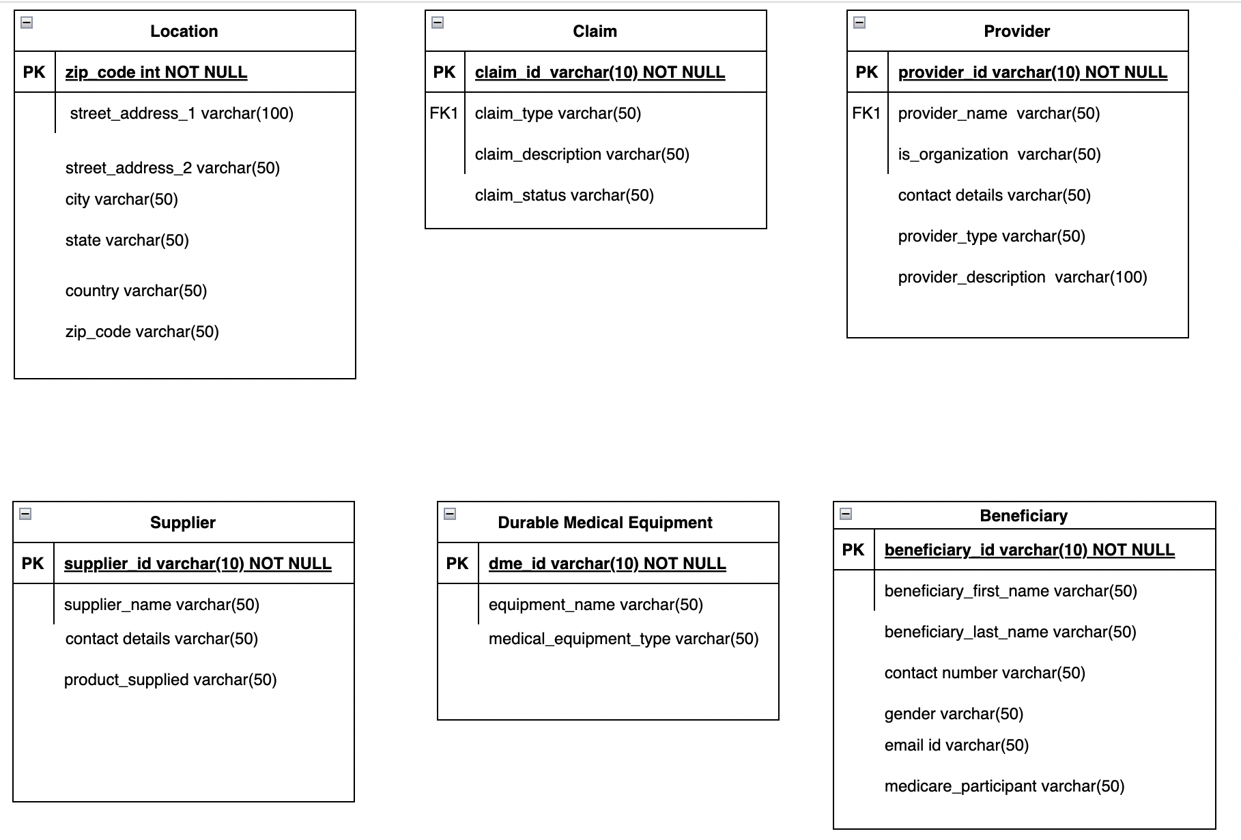
DIMENSION TABLES

Slide 30
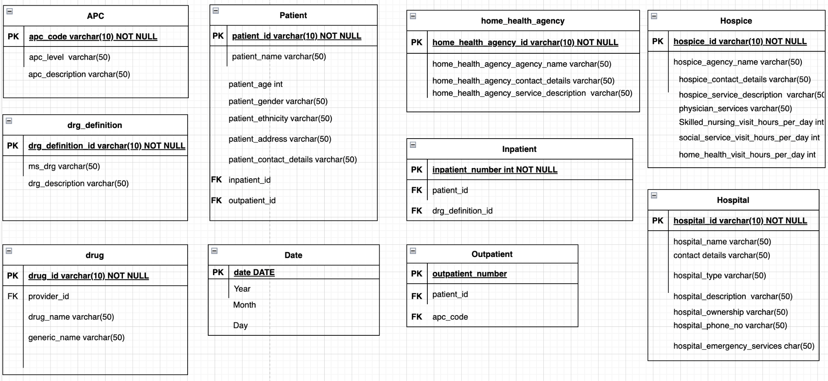
DIMENSION TABLES

Slide 31
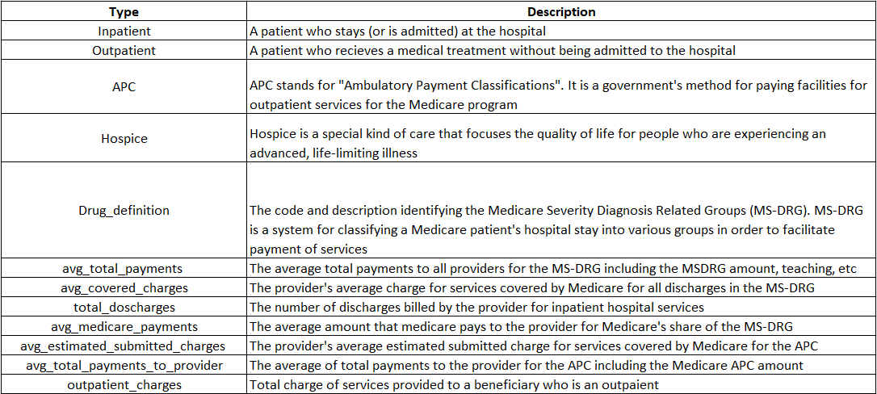
DIMENSION DESCRIPTION

Slide 32
SOME IMPORTANT POINTERS
BENEFICIARY AND PATIENT ARE TWO DIFFERENT VIEWS OF A SIMILAR DIMENSION. THUS, THEY ACT AS ROLE PLAYING DIMENSIONS
PATIENT/ BENEFICIARY ACT AS MONSTER DIMENSION DUE TO CONSTANT UPDATES. THUS, THEY CAN BE SPLIT INTO STATIC AND VARIABLE ATTRIBUTE’ TABLES
THE PRIMARY KEYS FOR ALL FACT TABLES AND EVEN DIMENSION TABLES ARE SURROGATE KEYS WHICH ARE SYSTEM GENERATED(NEWLY CREATED WITH UPDATED ROWS)

Slide 33
TRANSFORMATION RULES
Date | Transform the date to Format DD/MM/YYYY
Drug ID | Concatenation of Generic name, Provider ID ,and Drug Name in the format - GGPPPDDD
Outpatient Number | Concatenation of patient ID and APC code in the format of PPPP-AAA
APC Code | Concatenation of APC level and APC description in the format of LLLL-D

Slide 34
MDDB CUBES

Slide 35
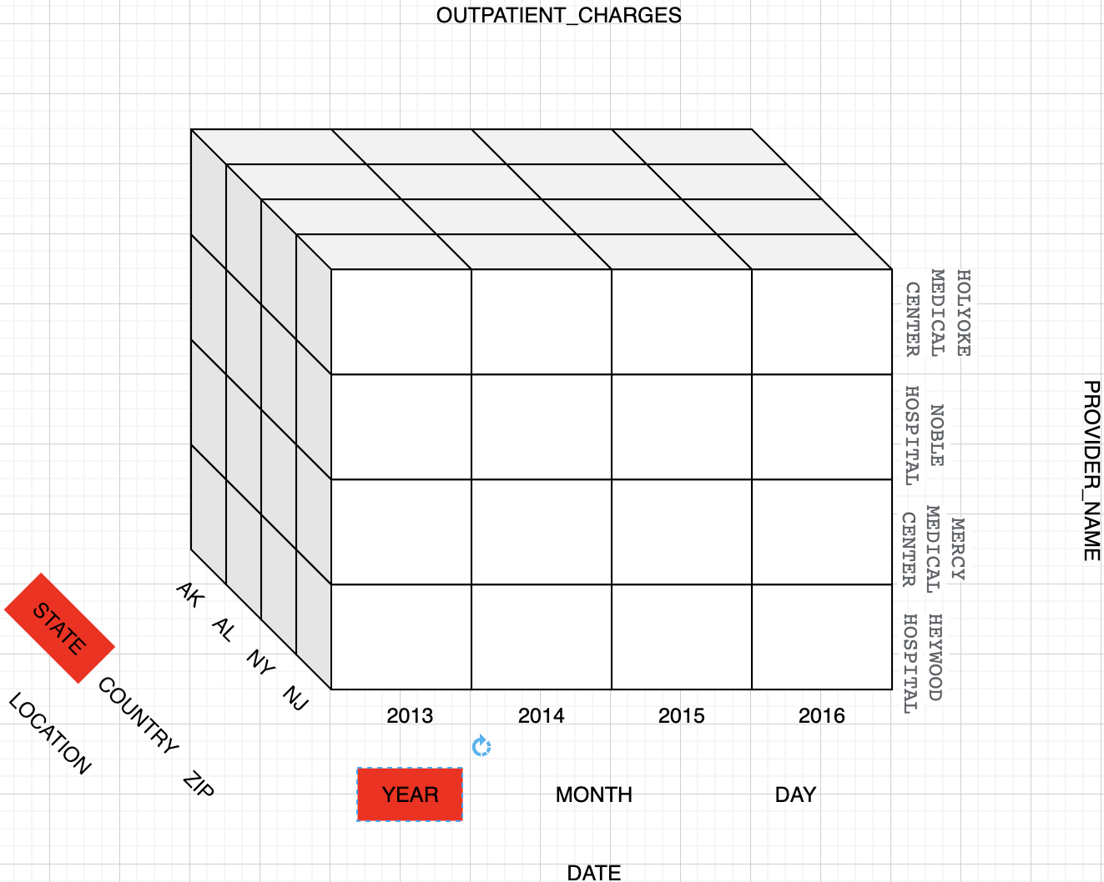
OUTPATIENT_CHARGES

Slide 36
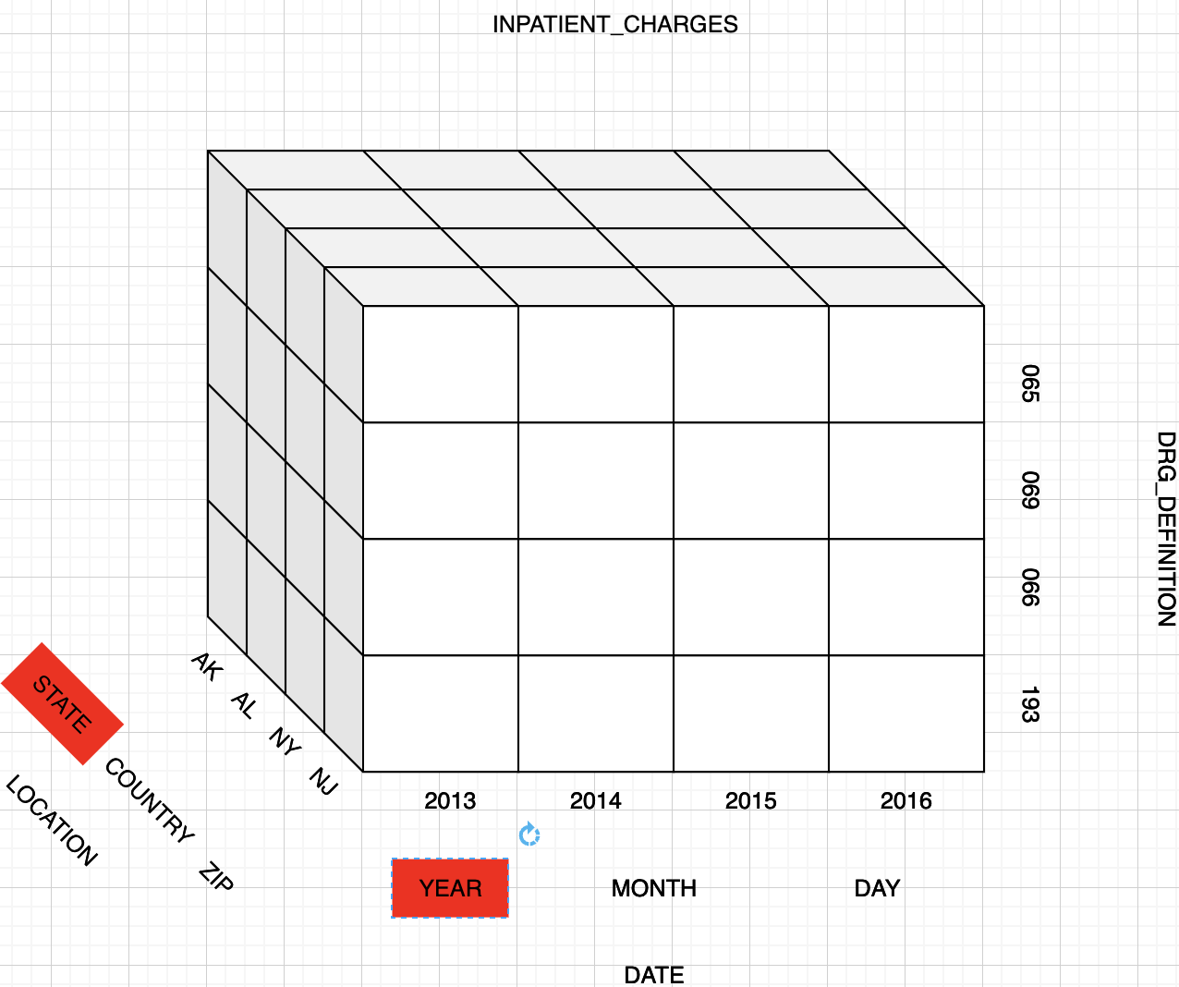
OUTPATIENT_CHARGES

Slide 37
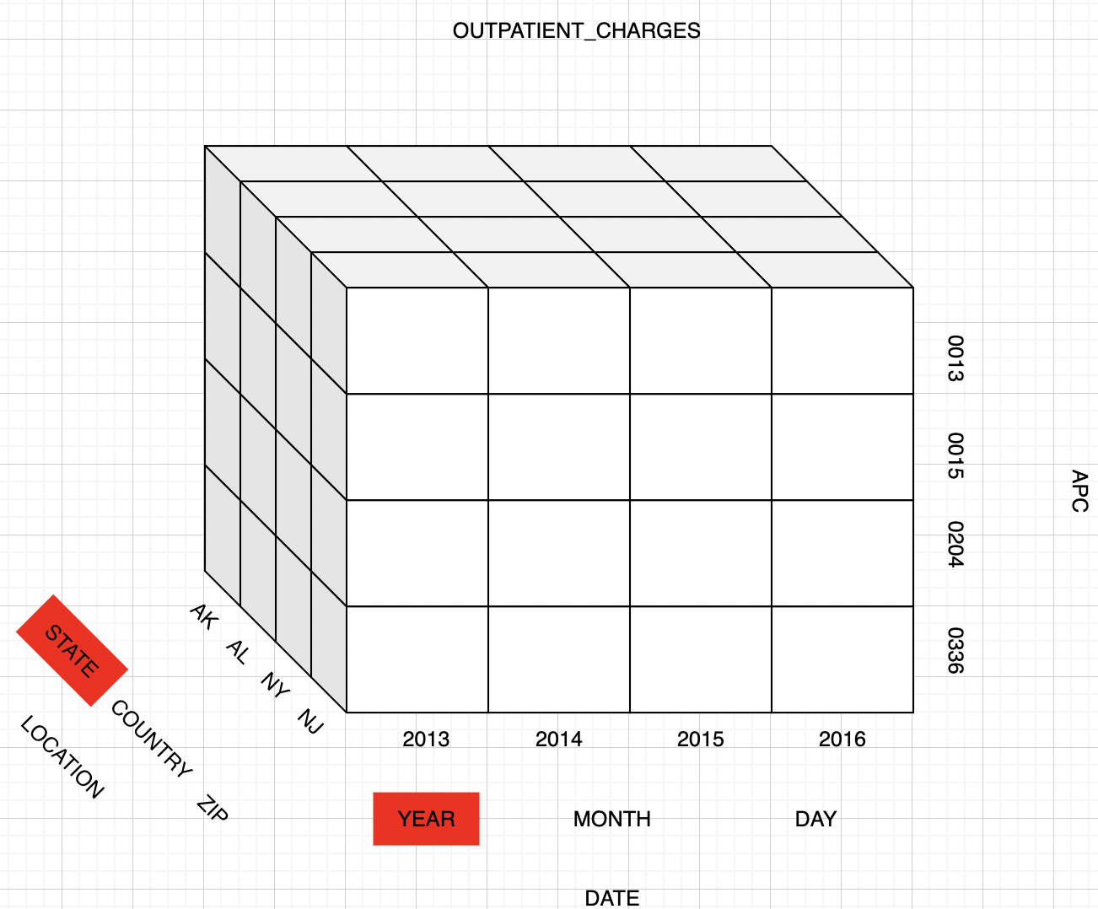
INPATIENT_CHARGES

Slide 38
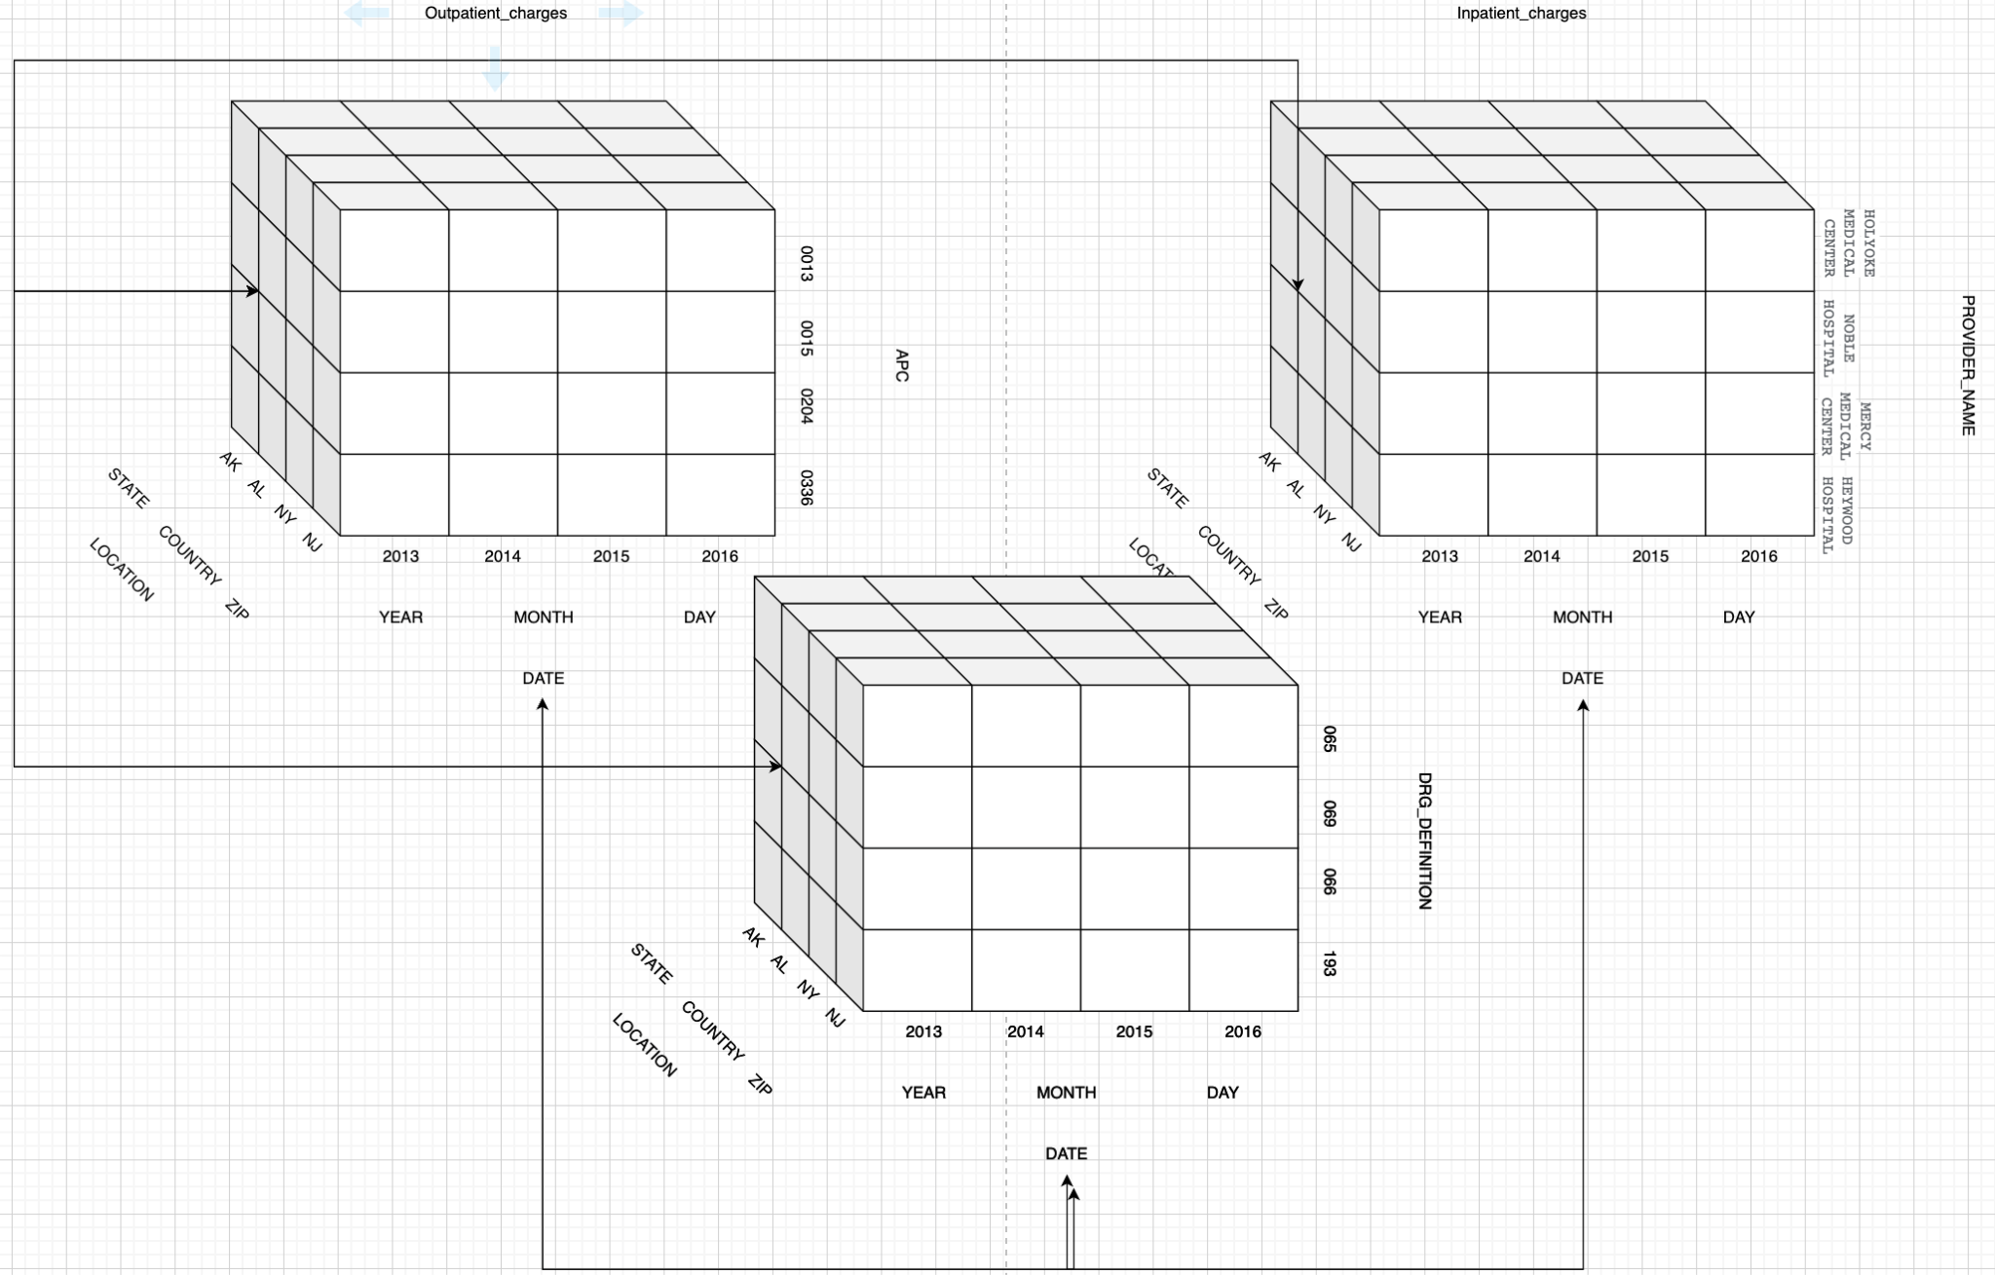
AGGREGATED CUBES

Slide 39
BI PORTAL AND SYSTEM DESIGN

Slide 40
BUSINESS CONTEXT
The BI system is aimed towards Medicare Organization(s) .
We can provide various information based on different combinations of facts but we have limited the information provided by the BI system based on inpatient and outpatient charges.
The BI system would provide various statistical insight across different location based on medical procedures performed and drugs prescribed by physicians.
The BI system has the capability to provide detailed relationships between the average medical charges and total payments for a said procedure in a single or multiple locations.
The system also has the capability to provide worldwide information owing to the fact that that data is stored in cloud and uses BigQuery to access it.

Slide 41
USER AND TASK ANALYSIS
Analyst: An analyst studies and maintain a database’s structure and upgrade relevant technology in order to ensure it produces value for an organization over time. He/she makes use of data available and try to extract useful information from it using different data manipulation and visualization tools
Manager: A database manager contributes to the creation of more efficient and consistent databases. They also determine the storage structures of the database
Developer: The role of a database developer is to design efficient databases
Project manager: A project manager makes use of process database for project planning, estimation, analysis of productivity and quality

Slide 42
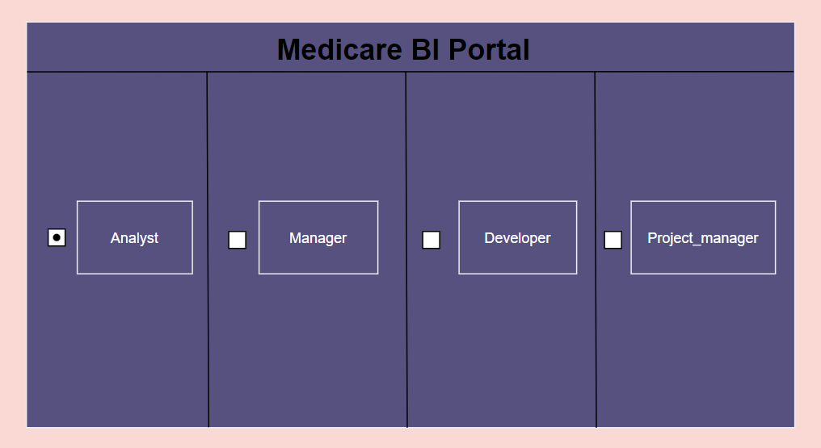
THE BI PORTAL

Slide 43
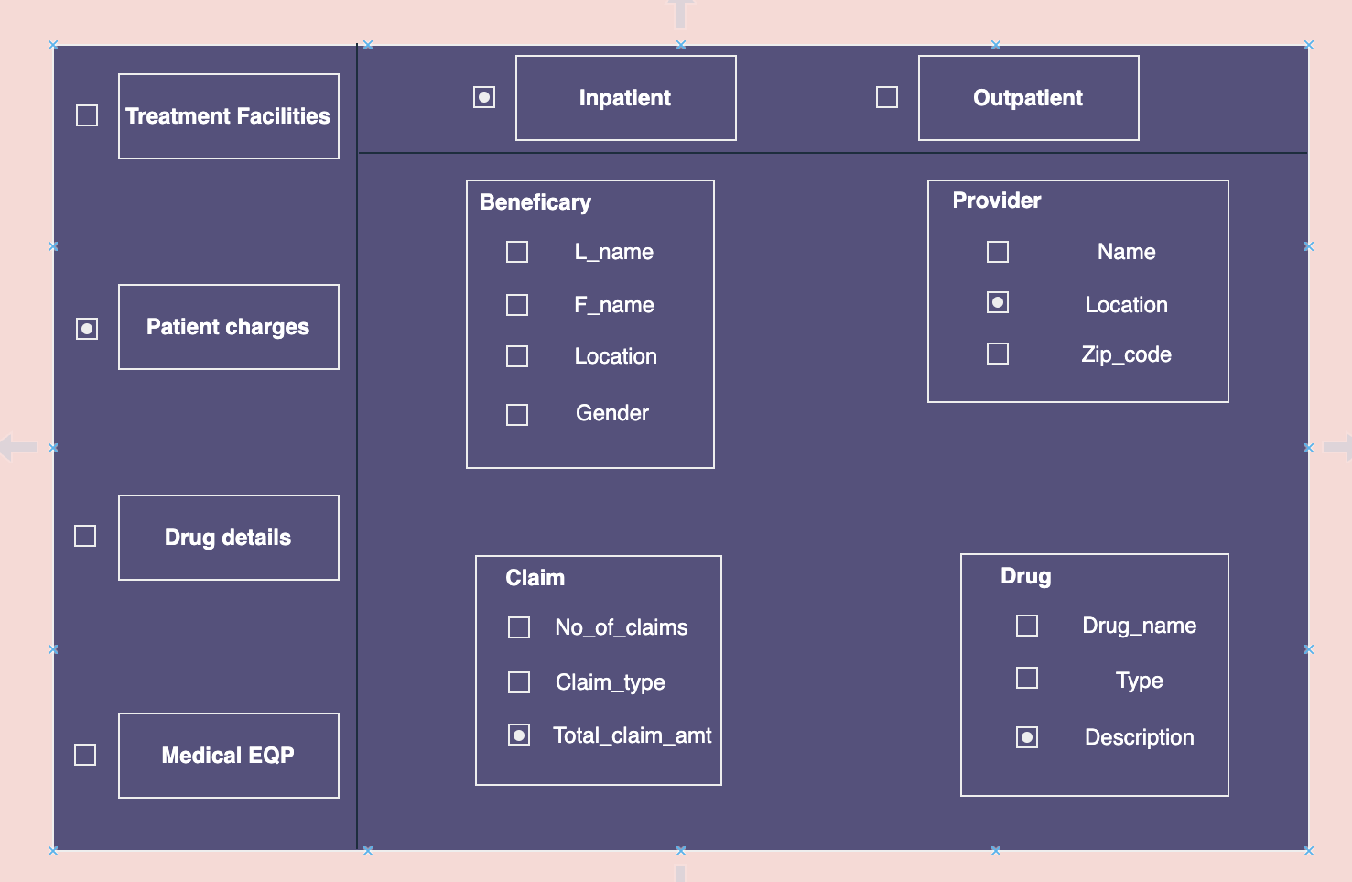
THE BI PORTAL

Slide 44
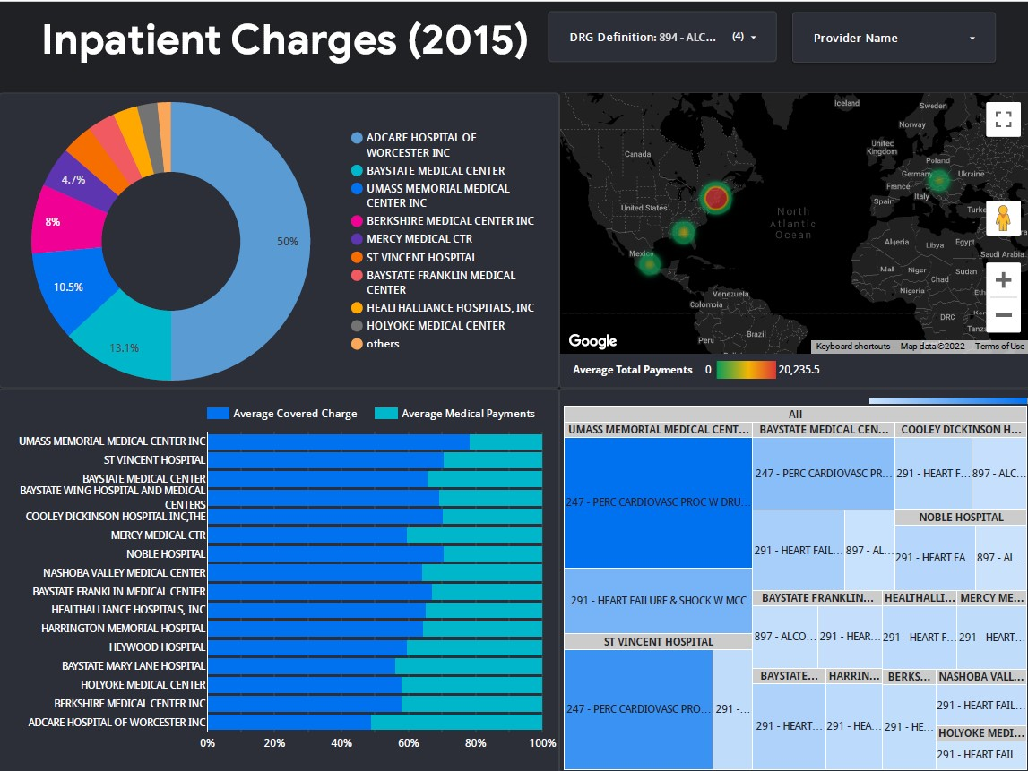
DASHBOARD AND VISUALIZATIONS
Link to the dashboard :
https://datastudio.google.com/reporting/28d4ece0-0b41-4126-901d-60511d9e082b

Slide 45
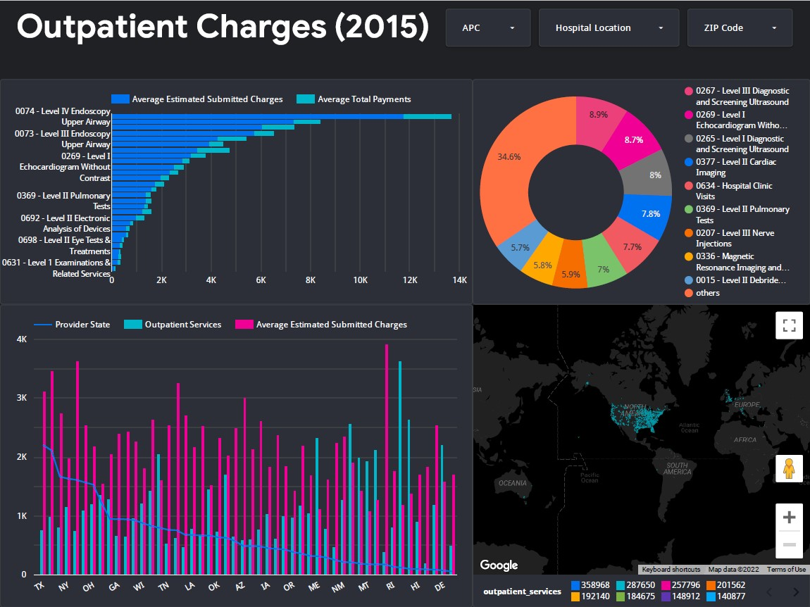
DASHBOARD AND VISUALIZATIONS
Link to the dashboard:
https://datastudio.google.com/reporting/cfe8d445-92c8-4289-bf9d-3e755c1ed5ae

Slide 46
REFERENCES
Kimball, Ralph, and Joe Caserta. The data warehouse ETL toolkit. John Wiley & Sons, 2004.
https://decisionworks.com/2003/09/the-bottom-up-misnomer/
https://en.wikipedia.org/wiki/Medicare_(United_States)
Tryfona, Nectaria, Frank Busborg, and Jens G. Borch Christiansen. "starER: A conceptual model for data warehouse design." Proceedings of the 2nd ACM international workshop on Data warehousing and OLAP. 1999.

Slide 47
RESOURCES
http://www.data.gov/privacy-policy#data_policy
https://cloud.google.com/bigquery/public-data/medicare
https://bigquery.cloud.google.com/dataset/bigquery-public-data:medicare
https://www.kaggle.com/datasets/cms/cms-medicare

Slide 48

Thank You !!

